Slide 1
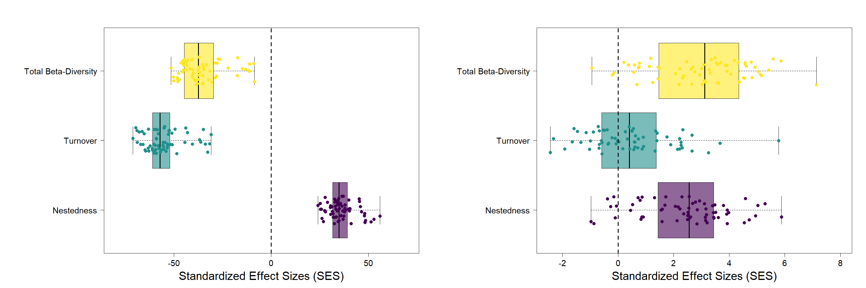
A
B
β-Diversity
***.
β-Diversity
.***
Turnover
***.
Turnover
.*
Nestedness
.***
Nestedness
.***
Standardized Effect Sizes (SES)
Standardized Effect Sizes (SES)

Slide 2
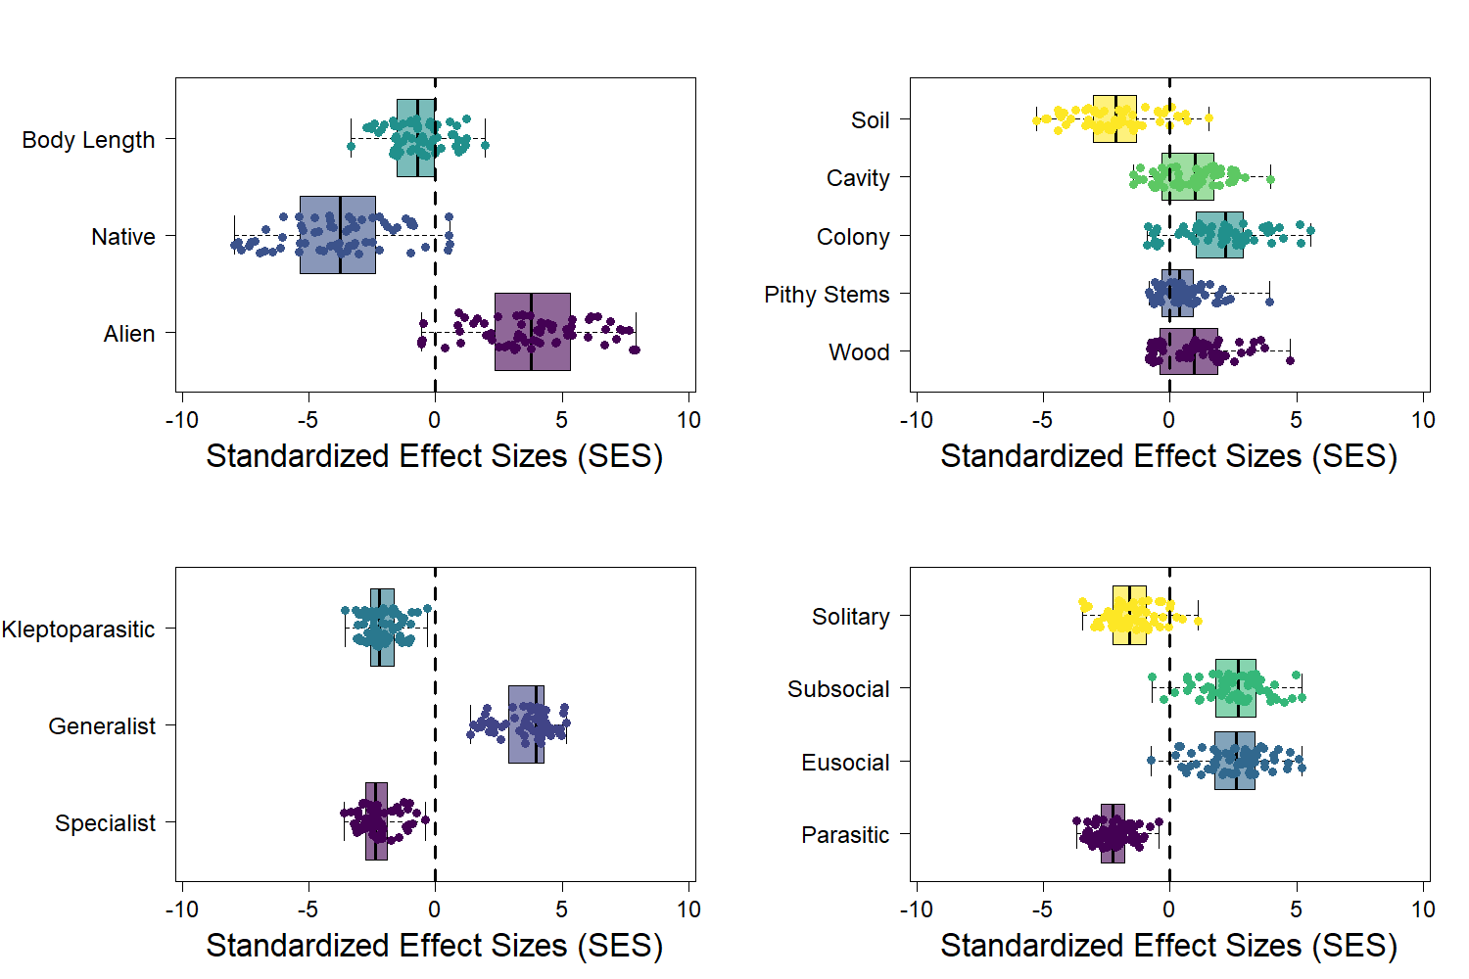
A
Soil
***
B
Body Length
***
Cavity
***
Native
***
Colony
***
Pithy Stems
***
Alien
***
Wood
***
Standardized Effect Sizes (SES)
Standardized Effect Sizes (SES)
C
Solitary
D
Kleptoparasitic
***
***
Subsocial
***
Generalist
***
Eusocial
***
Specialist
***
Parasitic
***
Standardized Effect Sizes (SES)
Standardized Effect Sizes (SES)

Slide 3
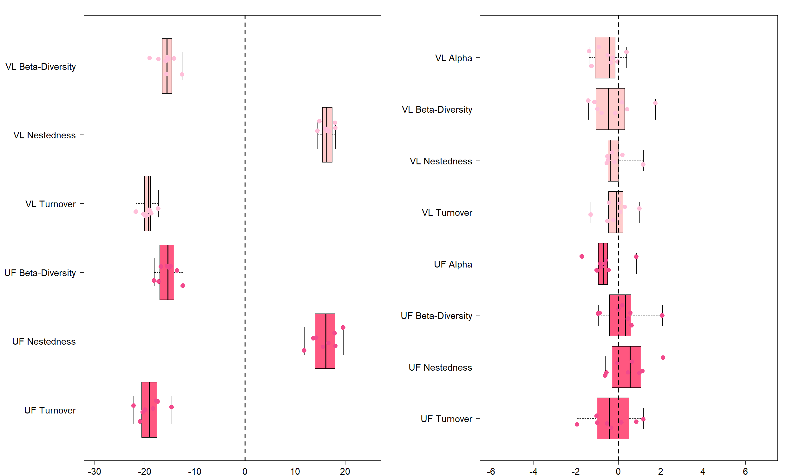
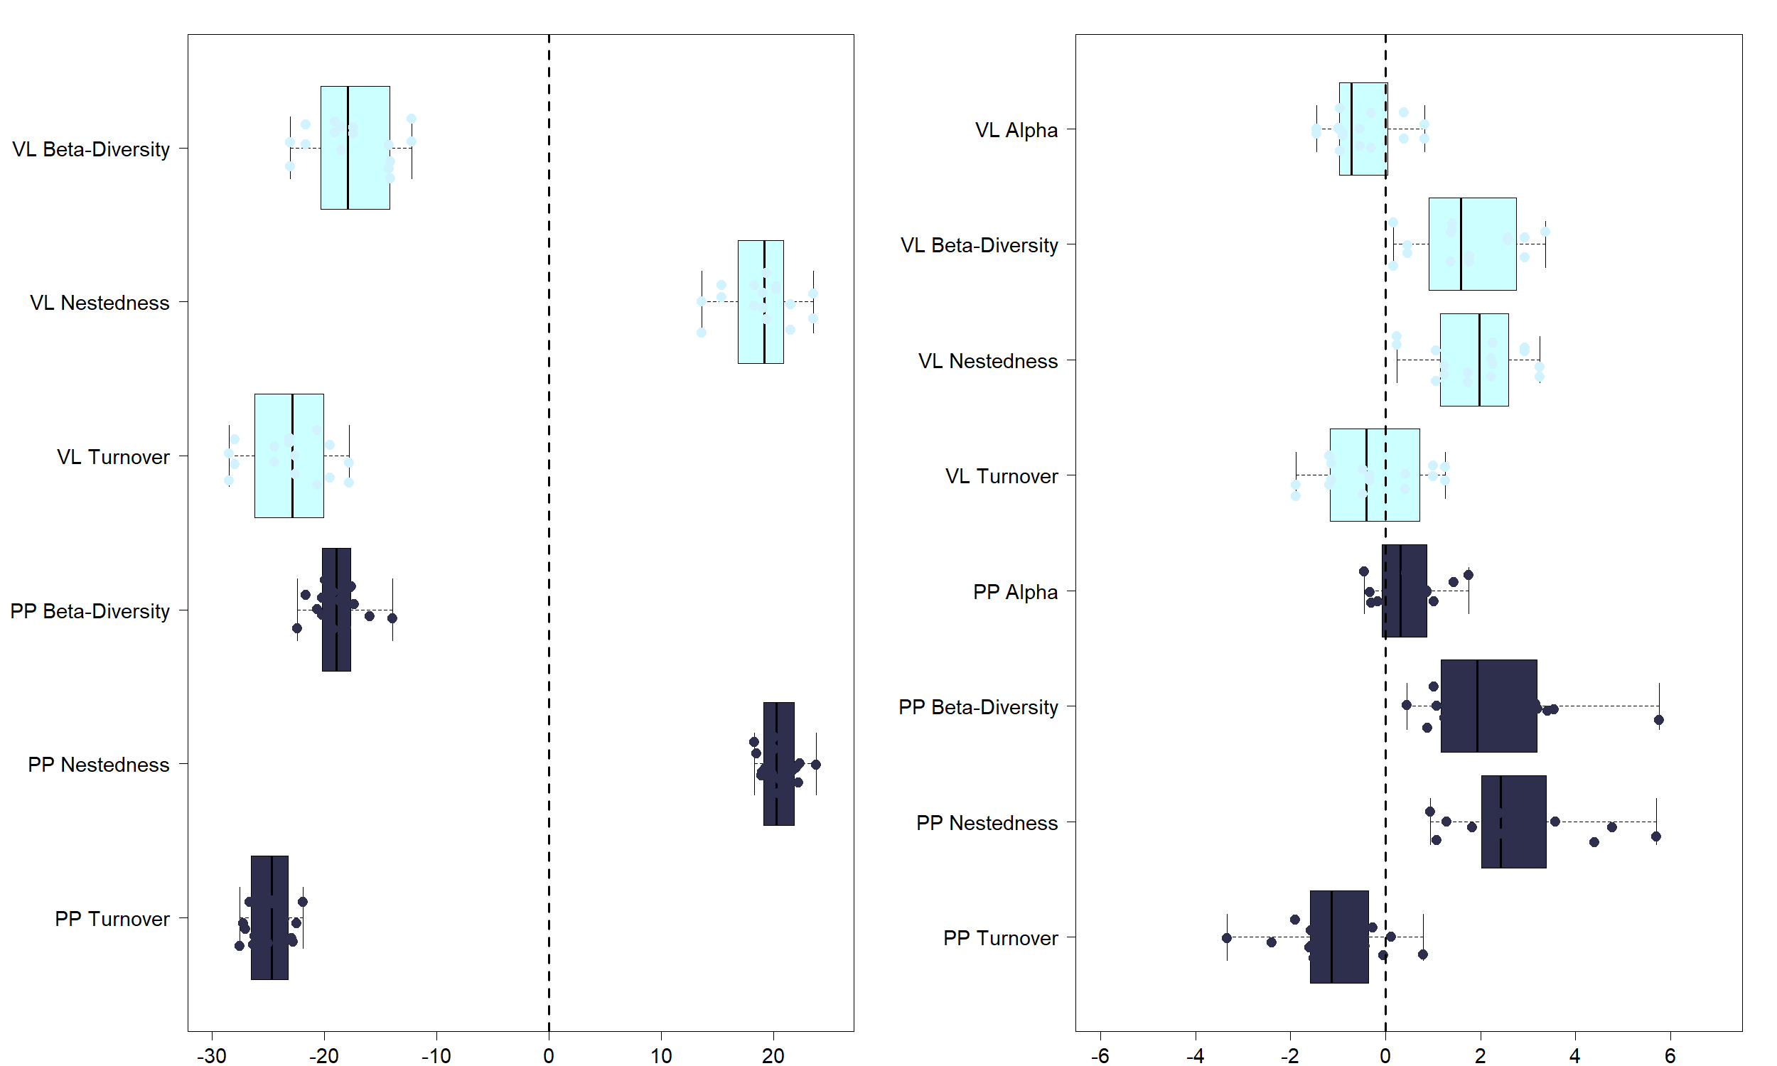
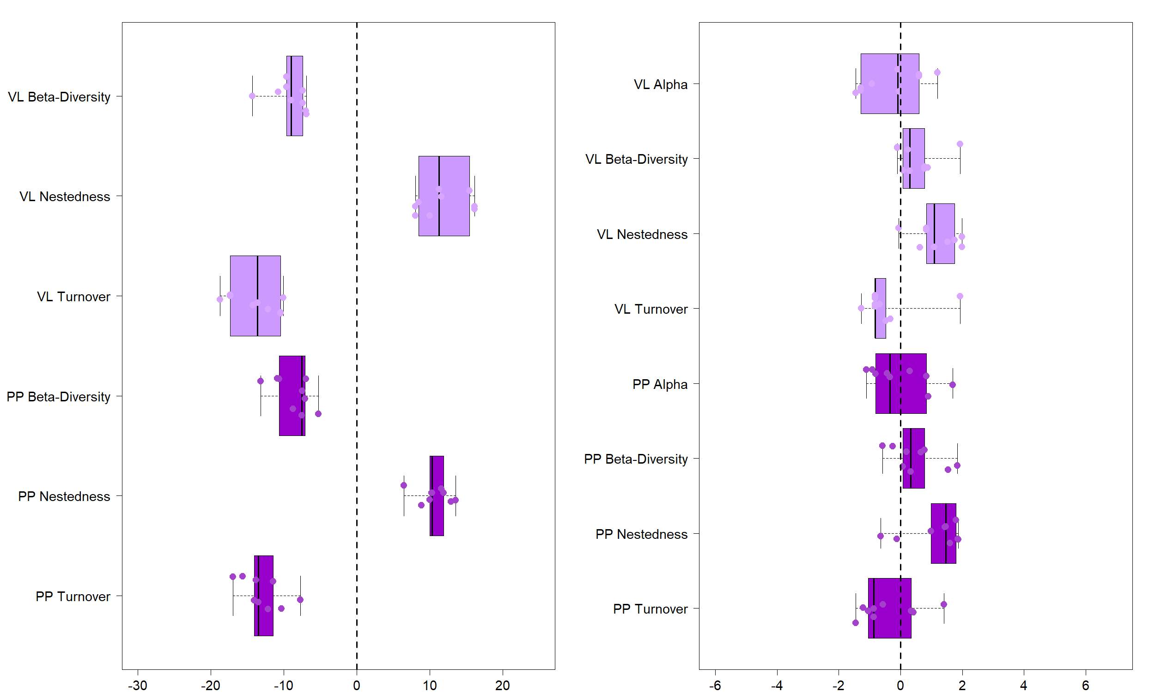
Sivakoff et al (2018)
Legend
Vacant Lots
Urban Farms
Taxonomic Diversity
Functional Diversity
β-Diversity
**
A
Alpha
*
B
Nestedness
**
β-Diversity
Turnover
Nestedness
**
Turnover
β-Diversity
**
Alpha
Nestedness
**
β-Diversity
Turnover
Nestedness
**
Turnover
Turo et al (2021)
Legend
Vacant Lots
Pocket Prairies
Taxonomic Diversity
Functional Diversity
β-Diversity
**
C
Alpha
D
Nestedness
**
β-Diversity
**
Turnover
Nestedness
**
**
Turnover
β-Diversity
***
Alpha
**
Nestedness
***
β-Diversity
***
Nestedness
***
Turnover
***
Turnover
**
Pham et al (in review)
Legend
Vacant Lots
Pocket Prairies
Taxonomic Diversity
Functional Diversity
β-Diversity
**
E
Alpha
F
Nestedness
**
β-Diversity
Nestedness
**
Turnover
**
Turnover
β-Diversity
**
Alpha
Nestedness
**
β-Diversity
**
Nestedness
**
Turnover
Turnover
Standardized Effect Sizes (SES)
Standardized Effect Sizes (SES)

Slide 4
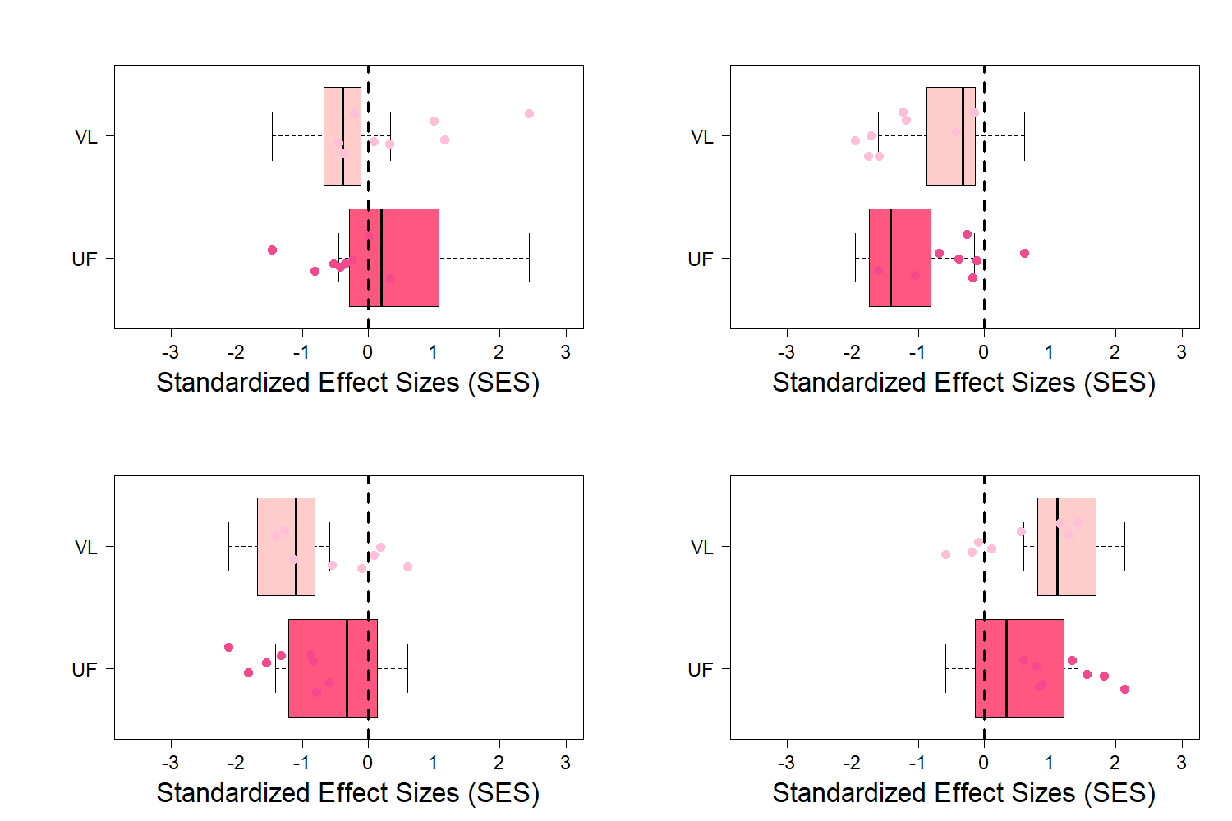
A
B
Vacant Lots
Vacant Lots
.*
.*
Urban Farms
Urban Farms
Standardized Effect Sizes (SES)
Standardized Effect Sizes (SES)
C
D
Vacant Lots
Vacant Lots
.*
.*
Urban Farms
Urban Farms
Standardized Effect Sizes (SES)
Standardized Effect Sizes (SES)

Slide 5
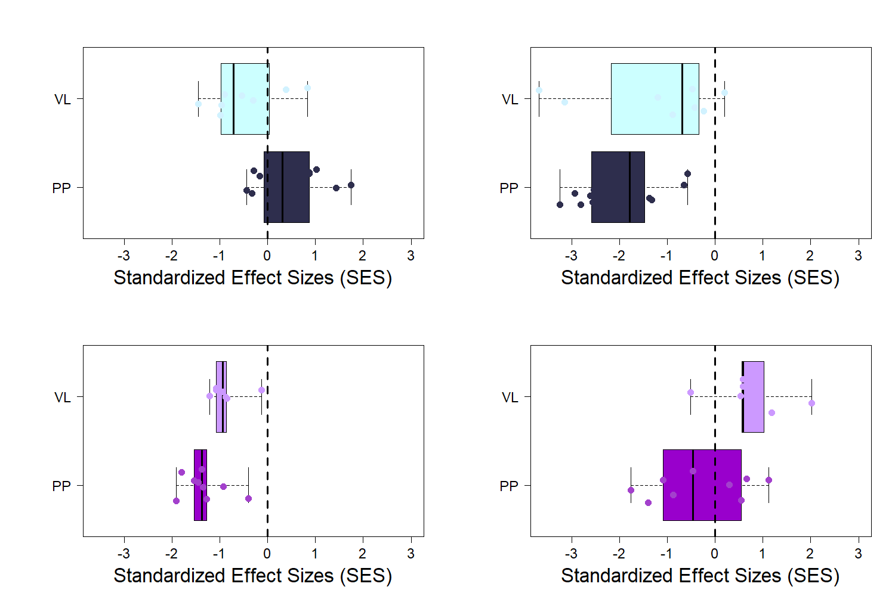
A
B
Vacant Lots
Vacant Lots
.***
.**
Pocket Prairies
Pocket Prairies
Standardized Effect Sizes (SES)
Standardized Effect Sizes (SES)
C
D
Vacant Lots
Vacant Lots
.*
.*
Pocket Prairies
Pocket Prairies
Standardized Effect Sizes (SES)
Standardized Effect Sizes (SES)

